Slide 1

4 famous women empowerment celebrities
By :- Aniket Dixit, Yughander Yadav, Ekjot Singh of Class 7th A

Slide 2
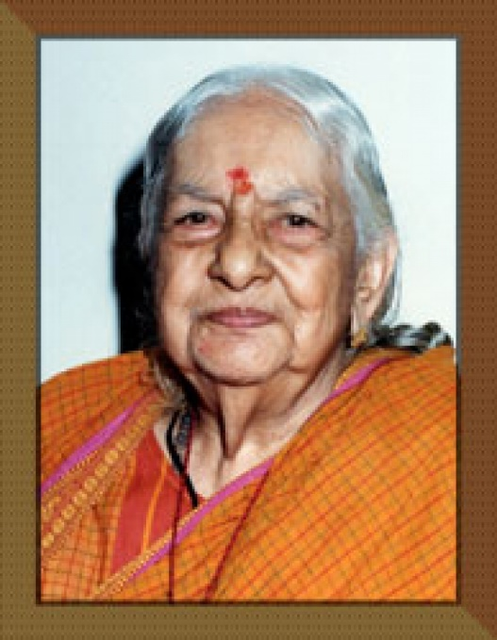
Kamaladevi Chattopadhyay
Kamaladevi Chattopadhyay (Born 3 April 1903 – 29 October 1988) was an Indian social reformer and freedom fighter. She was most remembered for her contribution to the Indian independence movement; for being the driving force behind the renaissance of Indian handicrafts, hand looms, and theater in independent India; and for upliftment of the socio-economic standard of Indian women by pioneering the co-operation.

